Slide 1
Dry Etch Chemistry - Si, SiO, & SiN
September 17th, 2024
Yongchul Yoo
Ph.D. in materials Engineering
Notes:
topic

Slide 2
Etch Chemistry
Additive gas
- Reactive
(O₂, H₂, N₂, CO, CH₄, etc.)
Etchant
- Halogen based feed gas in dry etch
(F, Cl, Br, C_{x}F_{y}, HBr, BCl₃, etc.)
Polymer formation - Anisotropic - Selectivity
Etchant concentration
- Selectivity
Additive gas
- Nonreactive
(Ar, He, Xe, etc.)
Ionization
Dilution of etchant
Heat transfer
Etch materials by chemical reactions
Provide the polymer precusor (C, H)

Slide 3
Etch Chemistry for Anisotropic/Selectivity
Si, SiO, and SiN
Anisotropic?
Prevent isotropic etching
Gas chemistry for passivation layer
- e.g. Polymer precusor, C
Anisotropic than F
Si,
Si: SiO selectivity
Cl₂
HBr
O₂
Br₂
Mitigation of microtrench
Anisotropic
Isotropic, Fast etching (F > Cl >Br)
Cryogenic condition
O₂
SiF₄/O₂
Si
SF₆
Selectivity?
Adjust etchant by additive gas to favor/suppress etching of specific films
O₂
Increase in F (etchant) up to certain level
Formation of oxide layer (if too much)
H₂
Decrease of F in CF plasma (HF)
Polymer formation on Si
N₂: Faciliatation of nitride etch (NO)
CH₄
SiO
NF₃
H₂
Si
Etch control
Anisotropic
O₂
Faster Si etch
Etching Si, SiO, and SiN
Selectivity control for Si, SiO, SiN
C_{x}F_{y}
H₂
Faster SiO etch
CHF
N₂
Faster SiN etch
Notes:
The purpose of this project is to improve corrosion by performing the supersonic laser deposition of CrNeNiTi high entropy alloy coating on stainless steel 316.
This presentation deals with
Nuclear energy future, and issue
Mitigation approach to improve the issue
What desired properties are
Coating method
Selected coating method
Candidate processing method per current coating
How to demonstrate the research
outcome

Slide 4
Etchant & additive example
Anisotropy of Si & Selectivity studies between Si, SiN, and SiO
Film 1 | Film2 | Selectivity (Film1 to Film2) | Goal | Etchant | Additive | Mechanism/Effect | Reference
Si | - | - | Anisotropic | SF₆ | O₂ | In cryogenic condtion, passivating layer, SiO_{x}F_{y}, Sulfur(S): no significant contribution to passivation layer At room temperature: no passivation layer | Passivation mechanisms in cryogenic SF₆/O₂ etching process
Si | - | - | Anisotropic | NF₃ | H₂ | Passive layer: (NH₄)₂SiF₆ Etching needs more than 40% of NF₃ | Reactive ion etching of crystalline silicon using NF₃ diluted with H₂
SiO | PR | 1.3 | Selectivity | SF₆ | CH₄ | Passive layer: CH_{x}F_{y} layer | Study of SiO₂ etching processing with CH₄/SF₆ plasmas
Si | SiO | 10 | Selectivity | CF₄ | O₂ | Up to about 23%, increase in F atom (CF₃ + O₂ reaction) Above 23% of oxygen, F decreases: electron energy reduction, oxidized Si surface | Downstream Etching of Si and SiO₂ Employing CF₄/O₂ or NF₃/O₂ at high temperature
SiO | Si | 45 (at high H₂) | Selectivity | CF₄ | H₂ | CF₄+ H₂ : Scavange Radical (F) (HF formation) Si etch: F, SiO₂: Both F and C contribute to etch | Parameter and Reactor Dependence of Selective Oxide RIE in CF₄+ H₂
SiO | Si | 15 | Selectivity | CHF₃ | CH₄ | F scavange by H atoms for CH₂ same as H₂ (main etching source for Si SiO: ion etching (sputtering) is more effective Produce a carbon rich fluorocarbon film on Si | SiO₂/Si SELECTIVITY IN HIGH DENSITY CHF₃ /CH₄ PLASMAS : ROLE OF THE FLUOROCARBON LAYER
SiN | SiO | 9 | Selectivity | CF₄ | O₂/N₂ | SiN: NO reacts with N (solid) in SiN SiO₂: independent of NO | Role of nitrogen in the downstream etching of silicon nitride
SiN | Si | 2 | Selectivity | CHF₃ | O₂ | SiN: O₂ acts as 1) Reactive F atoms by producing CO, CO₂, 2) Removal of N, 3) Flurocarbon film formation on the surface Si : Oxide layer formation to provide selectivity against SiN | Vertical sidewall of silicon nitride mask and smooth surface of etched-silicon simultaneously obtained using CHF₃/O₂ inductively coupled plasma
SiN | Si | 16 | Selectivity | CHF₃ | N₂ | Dilute the polymer-forming radicals Generates abundant N atoms to etch N from SiN | Selective reactive ion etching of silicon nitride over silicon using CHF₃ with N₂ addition

Slide 5
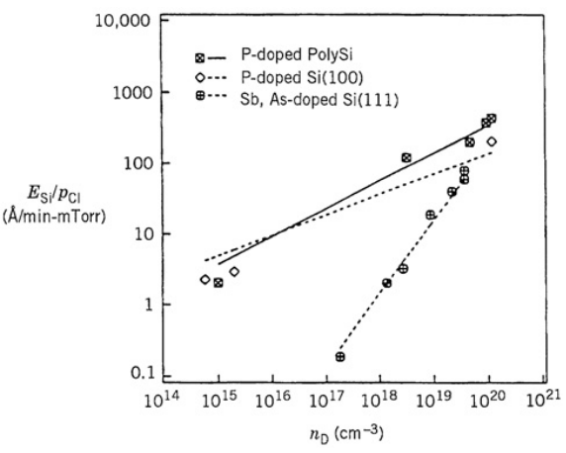

Film Dependency Etching
Doped film dependency etching : case study on (Si, Cl₂ etchant)
Undoped
N doped : Fermi level, E_{F} , approaches conduction band
E_{c}
E_{c}
E_{F}
Permits more available electron transfer from the silicon surface to chemisorbed Cl → Higher etch rate
E_{F} , E_{i}
E_{i}
E_{v}
E_{v}
P, Sb, As : n doping (electron)
E_{c} : Conduction band, E_{i} : Intrinsic, E_{v} : valence band, E_{F} : Fermi level (50% propability of electrons' occupation at any given time)
Crystallographic dependency for etch rate
The different area densities of silicon atoms (or Si –Si bonds) at the surface. The (111) orientation has a higher density than the (100) orientation, which reduces Cl or Cl penetration into the lattice for 111, leading to a lower etch rate
Reference: PRINCIPLES OF PLASMA DISCHARGES AND MATERIALS PROCESSING, Doping and crystallographic effects in Clatom etching of silicon

Slide 6
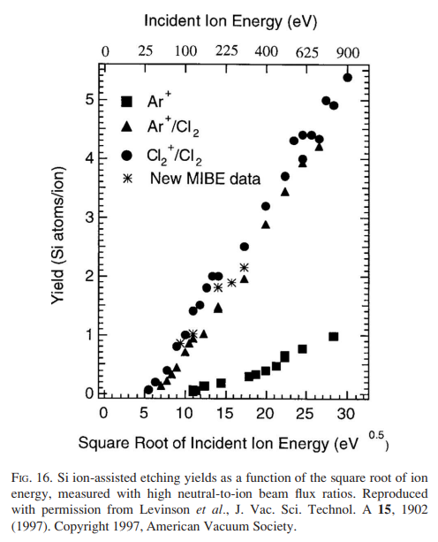
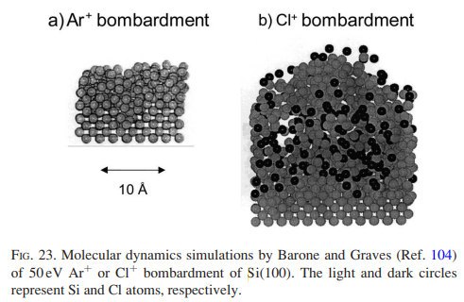
Film Dependency Etching
Ion dependency for etch rate
Higher etch rate by Cl^{2+/}Cl₂ > Ar⁺/Cl₂
Ar⁺ bombardment → Disordered but dense damaged layer
Cl²⁺ bombardment → Highly disordered, roughened layer with small subsurface voids. Such a layer contains more binding sites for adsorption by neutral Cl and Cl₂
Reference: Plasma etching: Yesterday, today, and tomorrow

Slide 7
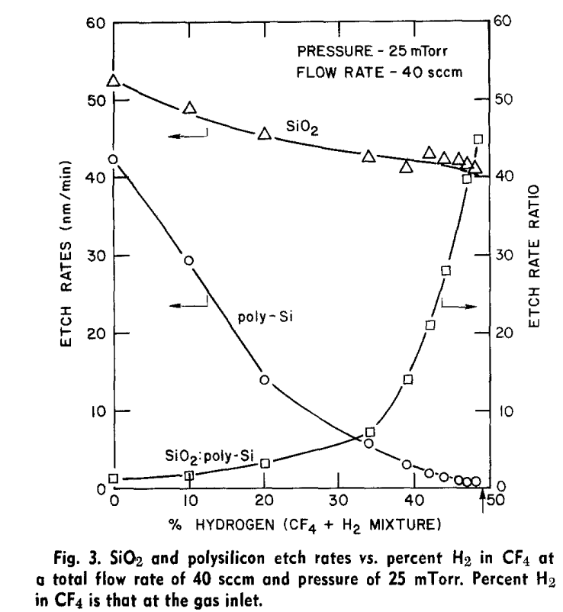
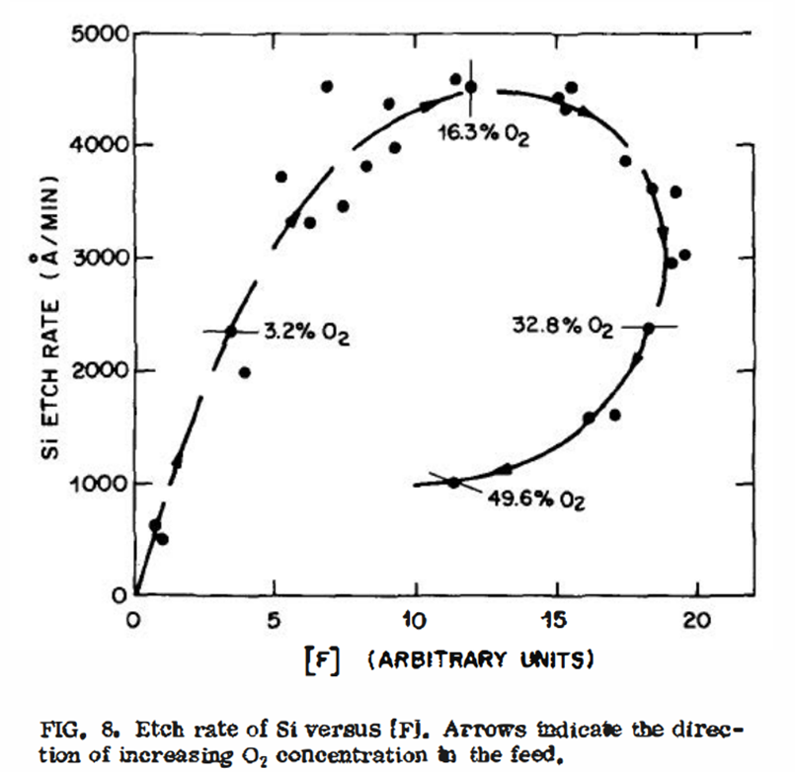
H₂ & O₂ Effect on Etching of SiO₂ & Si
Controlling behavior of Si and SiO
Si : Etching by F
SiO : Etching by both F and C, more efficient for sputtering by higher ion energy
Hydrogen Effect
Decrease in F by H+F → HF
Thicker film formation on Si than SiO₂
Oxygen effect
Up to certain level, increase in atom F by C_{x}F_{y}+ O → Liberate F
Above the certain level, decrease in atom F caused by quenching effect by high flow of dilution gas, oxidation of Si
CF₄/H₂
CF₄/O₂
Reference : Parameter and Reactor Dependence of Selective Oxide RIE in CF₄+ H₂
Reference : Plasma etching of Si and Si02-The effect of oxygen additions to CF4 plasmas

Slide 8
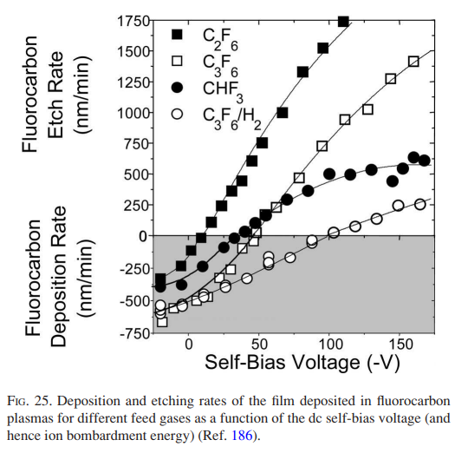
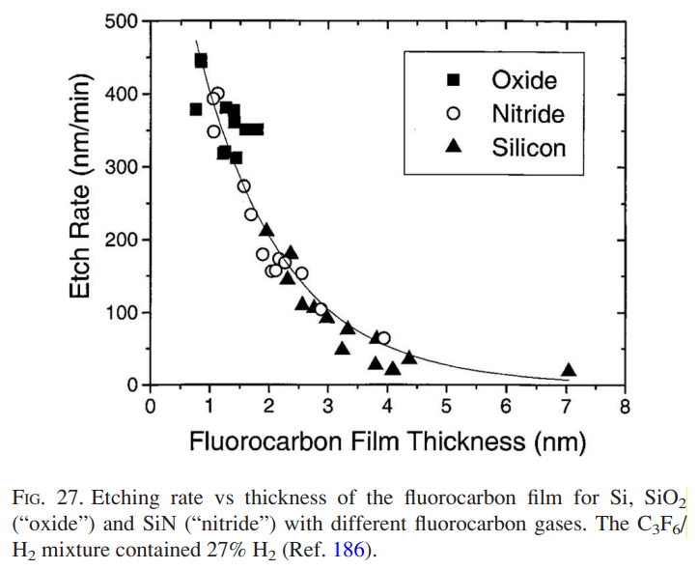
Fluorocarbon film behavior
Low bias voltage is effective to deposit polymers
The ratio of carbon and fluoride (x/y) C₃F₆ vs C₂F₆ → Thicker depostoin for C₃F₆
H inclusion further deposits CHF₃, and C₃F₆/H₂ → Thicker deposition
Passivation layer
Reactants during ion bombardment
Reference: Plasma etching: Yesterday, today, and tomorrow

